Slide 1
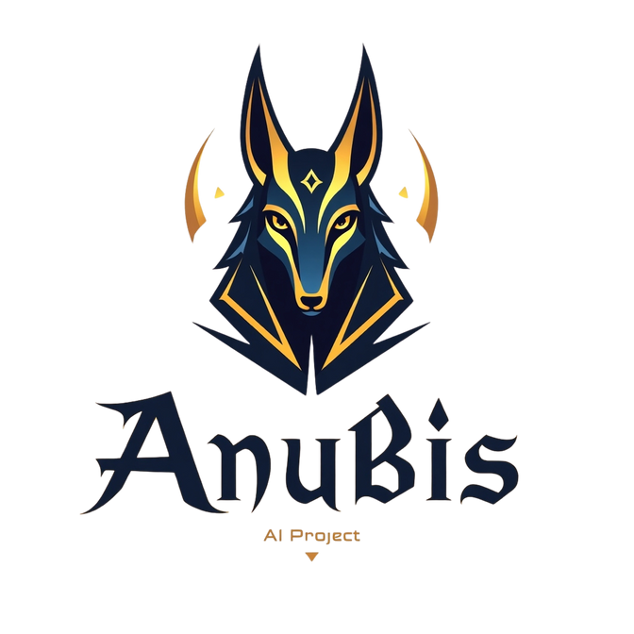


G
P
T
WELCOME
ANUBIS
Exploring Cutting-Edge Technology Shaping The Future

Slide 2

PAGE 01
G
P
T
ANUBIS
Exploring Cutting-Edge Technology Shaping The Future

Slide 3
PAGE 02
ABOUT
PROJECT
AnubisGPT is an intelligent Java-based desktop chatbot application built with a sleek Swing UI.It integrates with the OpenRouter API to deliver smart, real-time AI responses using state of-the-art LLMs. The chatbot supports both text and voice interaction, featuring FreeTTS for voice output. It offers a modern interface with message bubbles, bot/user avatars, and a customizable chat experience.Speech input can be added using CMU Sphinx or cloud services like Azure or ElevenLabs.Users can toggle voice on/off and enjoy seamless conversations with AI in a desktop app format. AnubisGPT demonstrates natural language processing, API integration, and user-centric design.

Slide 4


PAGE 03
KEY
1.
UI
FEATURES
The UI of AnubisGPT features a clean, modern chat interface with a top bar for branding, a scrollable chat area, and a responsive input section with voice and send controls
2.
API INTEGRATION
AnubisGPT uses OpenRouter API to send queries and receive AI responses securely via HTTP requests.
3.
VOICE INTEGRATION
AnubisGPT integrates FreeTTS to convert AI responses into clear, natural voice-based speech output.

Slide 5
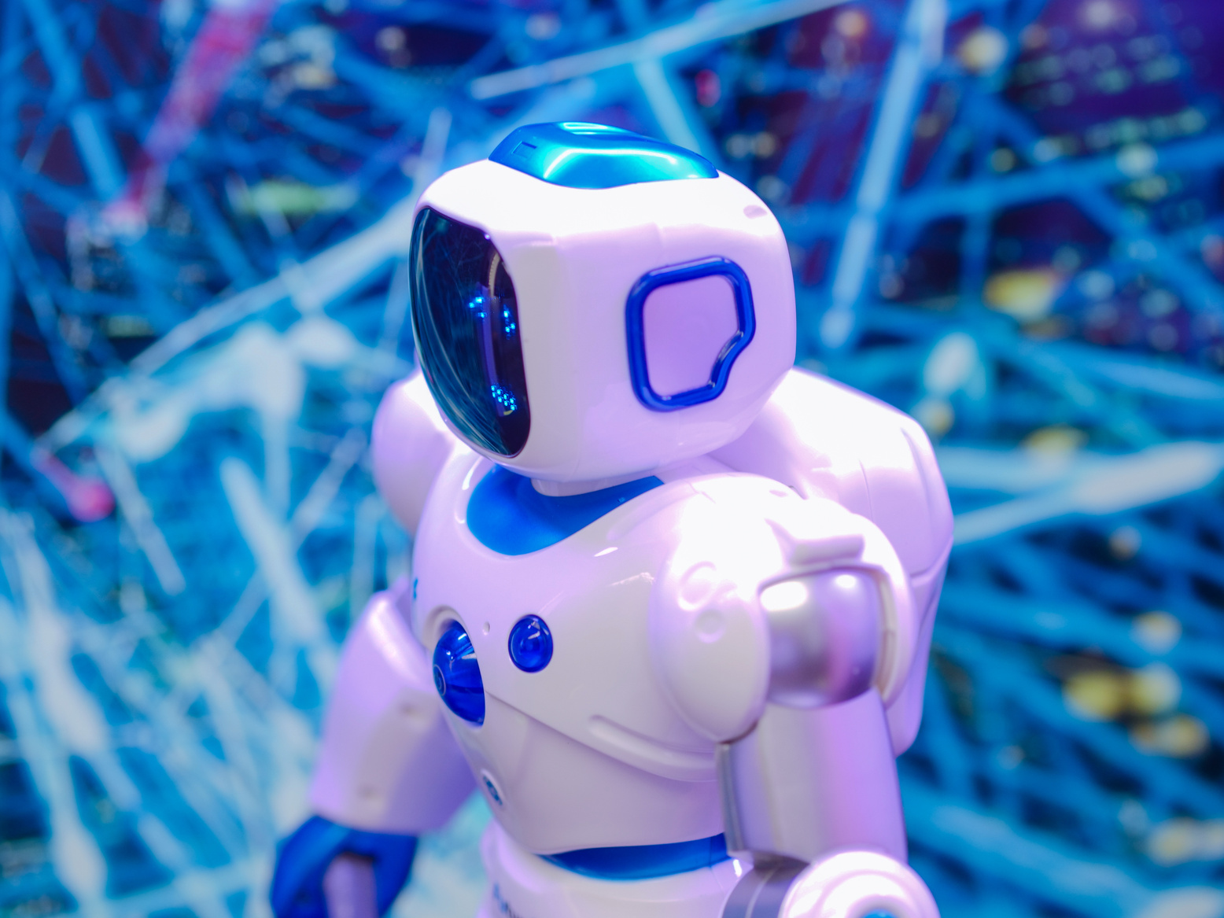

PAGE 04
TECHNOLOGIES
USED
Java Swing – For building GUI
OpenRouter API – For AI-powered responses
FreeTTS – For Text-to-Speech Output
Gson Library – For handling JSON data
HTTPURLConnection – To connect with API

Slide 6
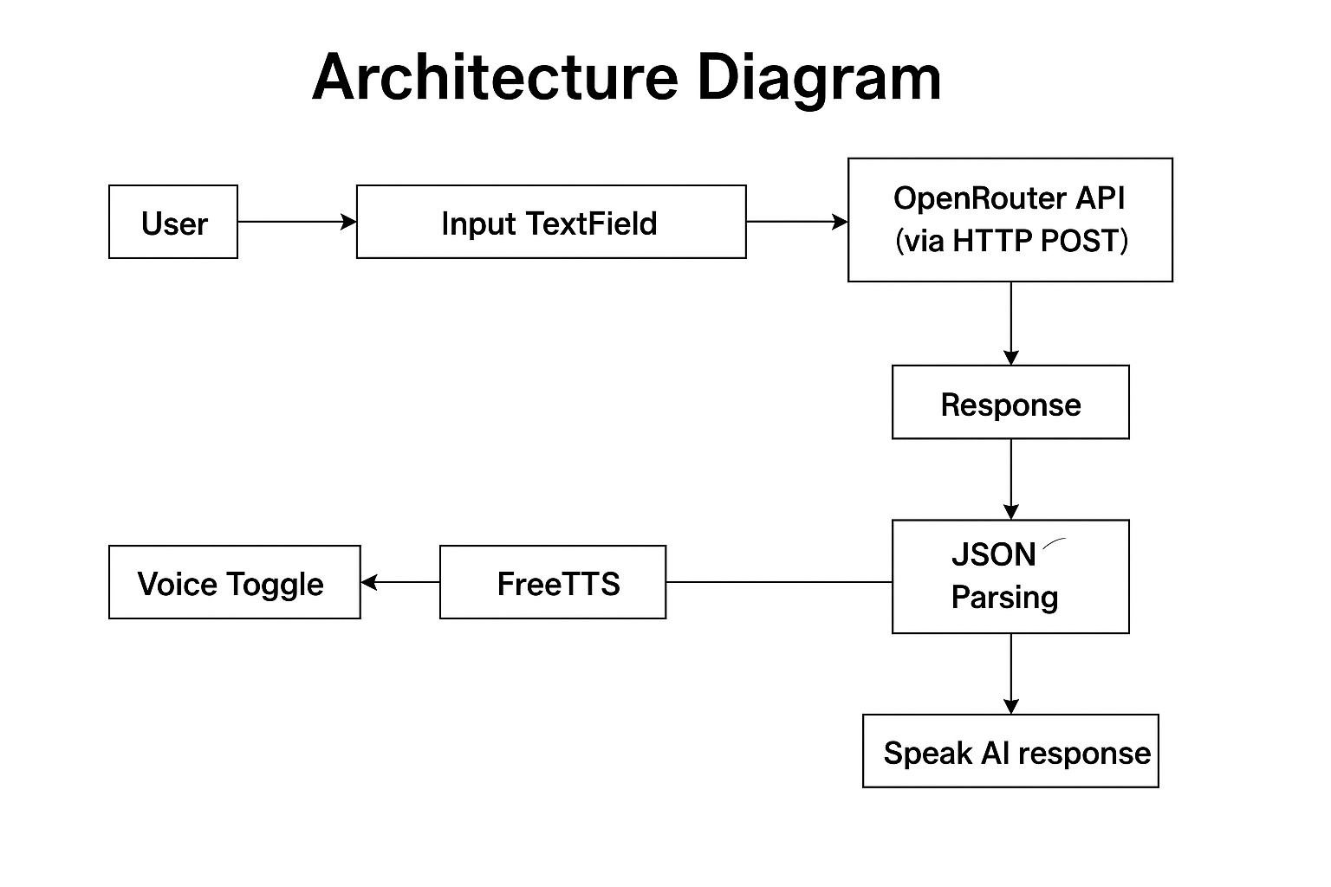
PAGE 05
HOW IT WORKS
User types a message in the input field.
Message is sent to OpenRouter via API.
OpenRouter processes and returns a response.
Response is shown in chat, and optionally spoken using FreeTTS.

Slide 7


PAGE 06
API
INTEGRATION
The code integrates the OpenRouter API to connect with various large language models (LLMs), specifically using for Neural Processing. The API interaction follows a structured approach .First, it sends a POST request to
(https://openrouter.ai/api/v1/chat/completions) with the necessary headers, including the API key for authentication. The request body contains the user's code snippet and the selected programming language, formatted as a prompt for the LLM. The chosen model, `google gemini 2.0 flash`, is a loaded model yet efficient 278-billion-parameter variant of LLaMA, optimized for faster inference while maintaining reasonable accuracy. The response is processed asynchronously to prevent UI freezing, and the AI-generated explanation is extracted from the JSON response. If the API call fails, a fallback message is displayed. This setup ensures real-time, language-specific code explanations while maintaining a smooth user experience.

Slide 8

PAGE 07
CODE
ARCHITECTURE
1.
2.
3.
4.
GUI setup and event handling in Anubius.java
API Request in getAIResponse() method
JSON parsing using Gson &
Threading ensures smooth response fetching
Voice integration using FreeTTS

Slide 9
PAGE 08
VOICE
INTEGRATION
The AnubisGPT Java chatbot integrates FreeTTS, a speech synthesis library, to provide voice-based responses. By importing com.sun.speech.freetts.*, the project enables text-to-speech (TTS) functionality within the application. The VoiceManager is used to retrieve the "kevin16" voice, which is then allocated for use during the app’s initialization. Voice playback is handled in the speak(String text) method, where voice.speak(text) is called to convert the AI's response into audible speech. This operation runs inside a new thread to keep the graphical interface responsive and prevent blocking. Additionally, the application includes a voiceToggleButton that allows users to enable or disable the voice output dynamically. This integration improves the interactivity and accessibility of the chatbot by giving users an optional audio response feature.

Slide 10
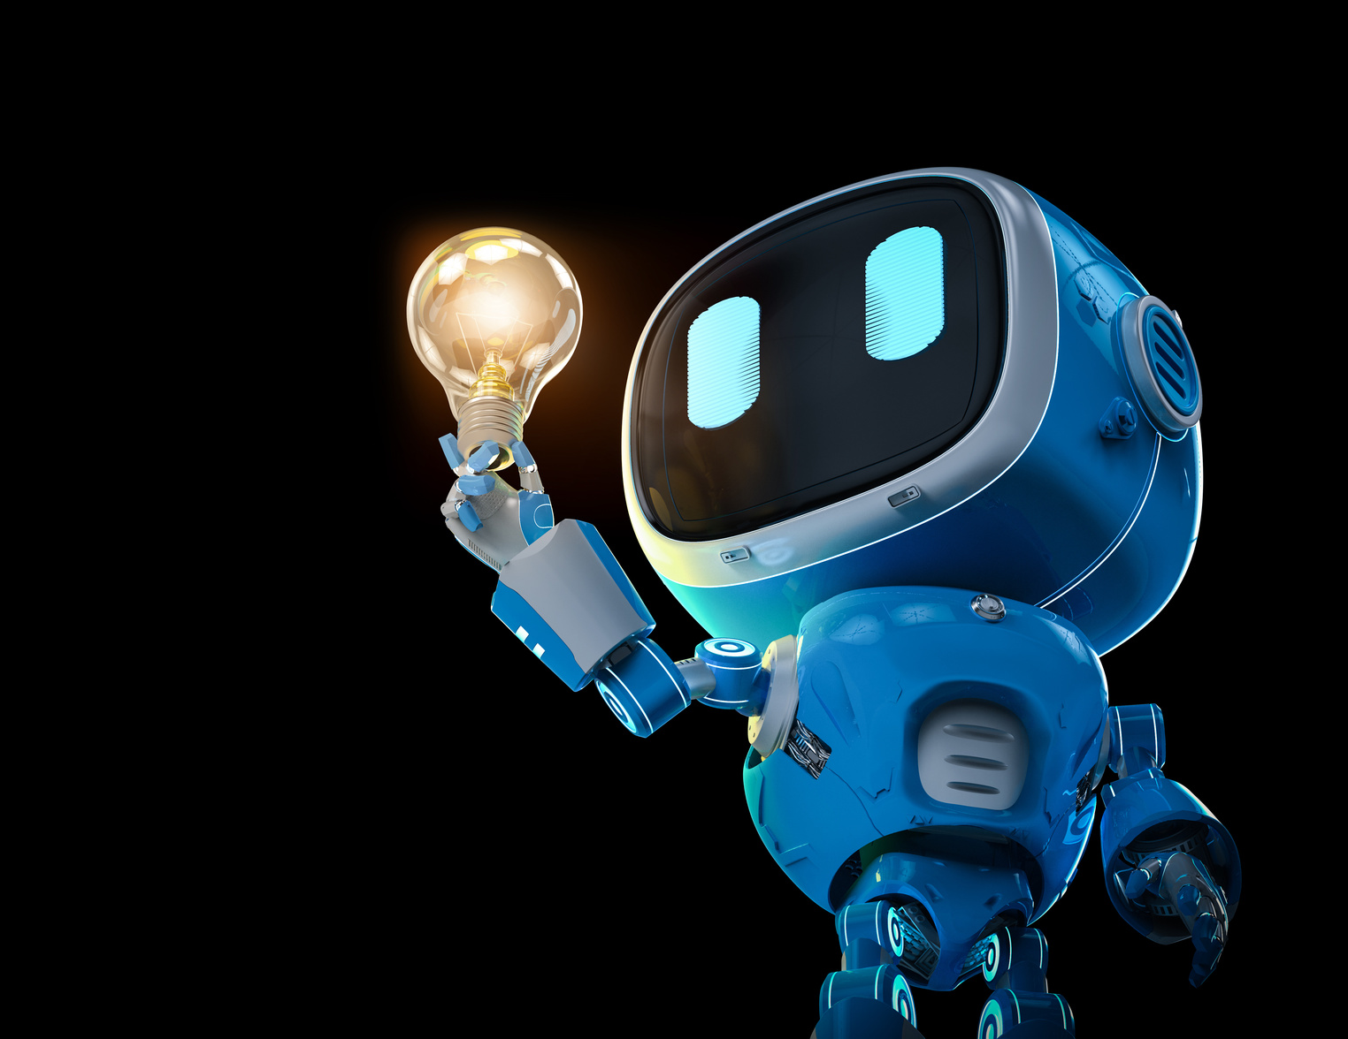
PAGE 09
CHALLENGES &
SOLUTIONS
1.
ISSUE: PARTIAL/HALF-LINE RESPONSES
Solution: Proper JSON parsing and multi-line text rendering
2.
ISSUE: BLOCKING UI ON REQUEST
Solution: Used background threads for API calls

Slide 11

PAGE 10
FUTURE
ENHANCEMENTS
1.
Add Speech-to-Text (Voice input)
2.
Implement local model (like Ollama or GPT4All)
3.
Add chat history saving and export
4.
Mobile or web version of the app

Slide 12
PAGE 11
THANK
YOU!

